Slide 1
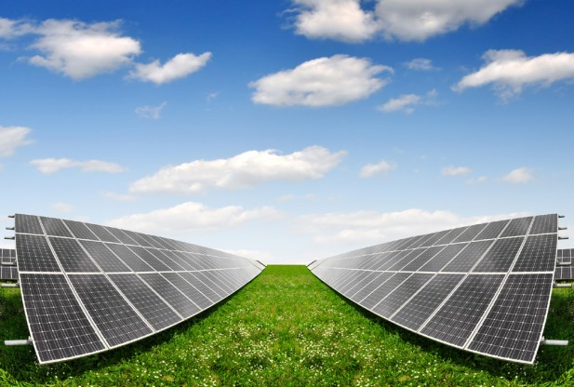
AUTOMATED SOLAR WATER PUMPING SYSTEM
TEAM SHADOW
TEAM ID : 135

Slide 2
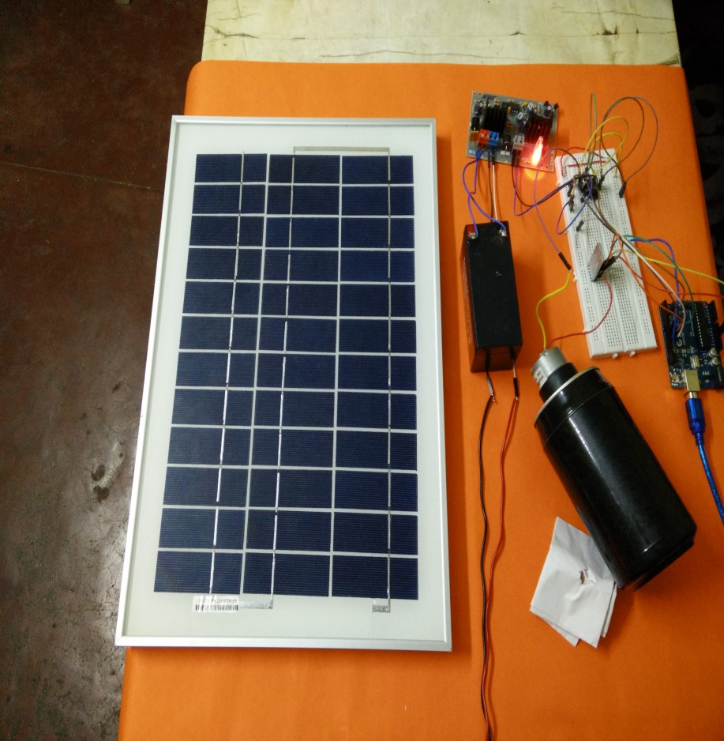
Following our timeline, we have developed the prototype. Our week wise progress is as follows:
Week 4 :
Acquired the solar panel and other electrical components. Built the circuit without using Bluetooth and successfully tested it.
Worked on developing the pumping system.

Slide 3
Week 5 :
Wirelessly controlled the motor using PC and then through android app.

Slide 4
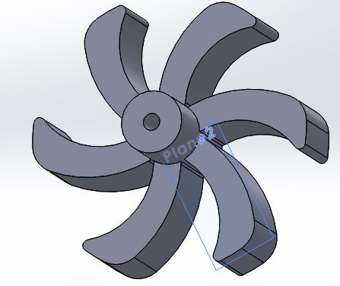
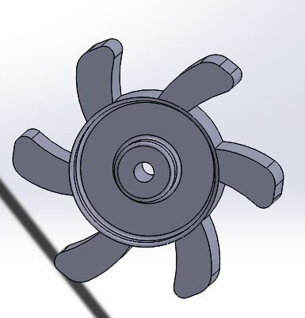
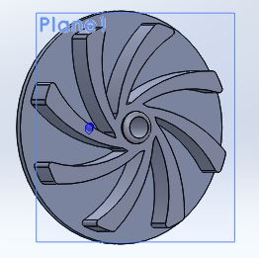
Completed the impeller design but discarded it as it turned out to be too expensive (around Rs.1800).
Redesigned the impeller and made it cost effective to some extent.
Initial design with approximations
Cost ineffective design
Final design

Slide 5
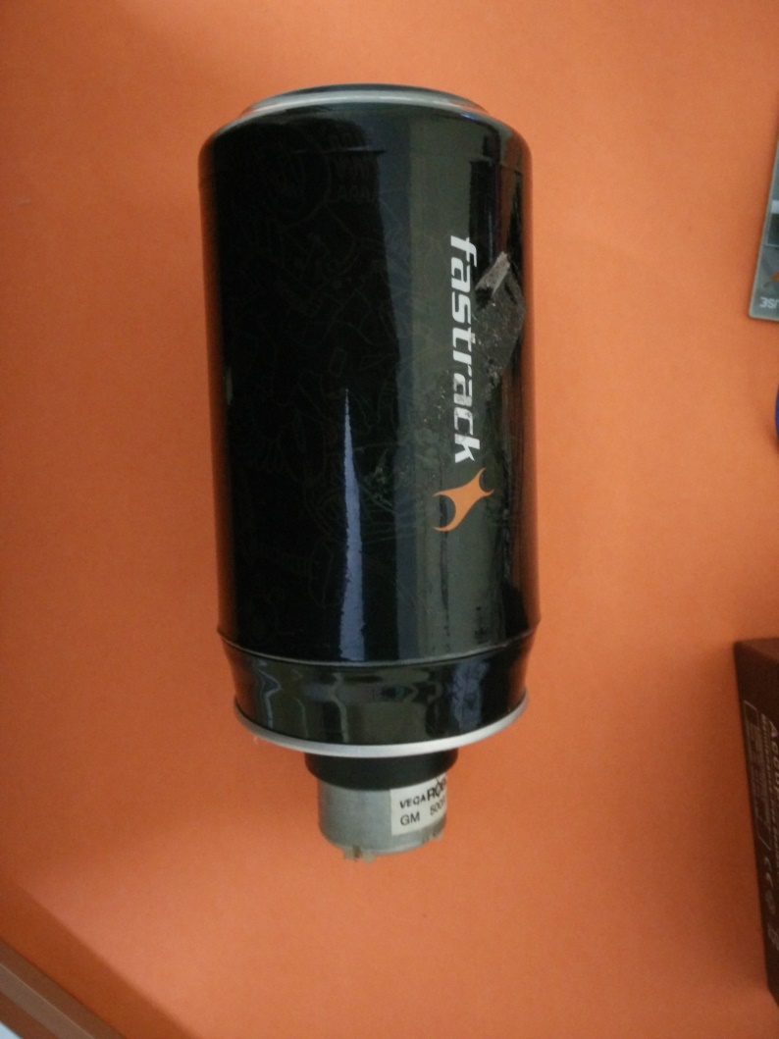
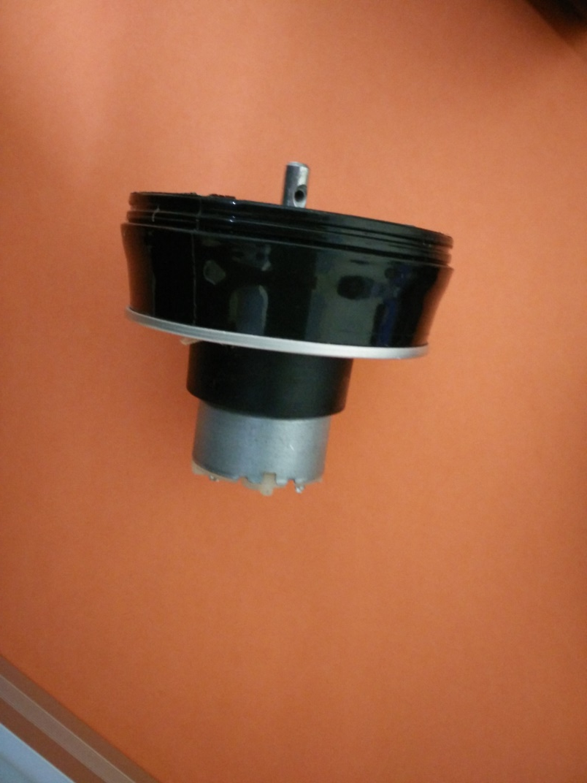
Started making the pumping model outer structure using available items.

Slide 6
TEAM MEMBERS :
Lavan Teja
Sreekar Reddy
Mounica N
Sushmitha Sree

Slide 7
THANK YOU !!!

